Slide 1

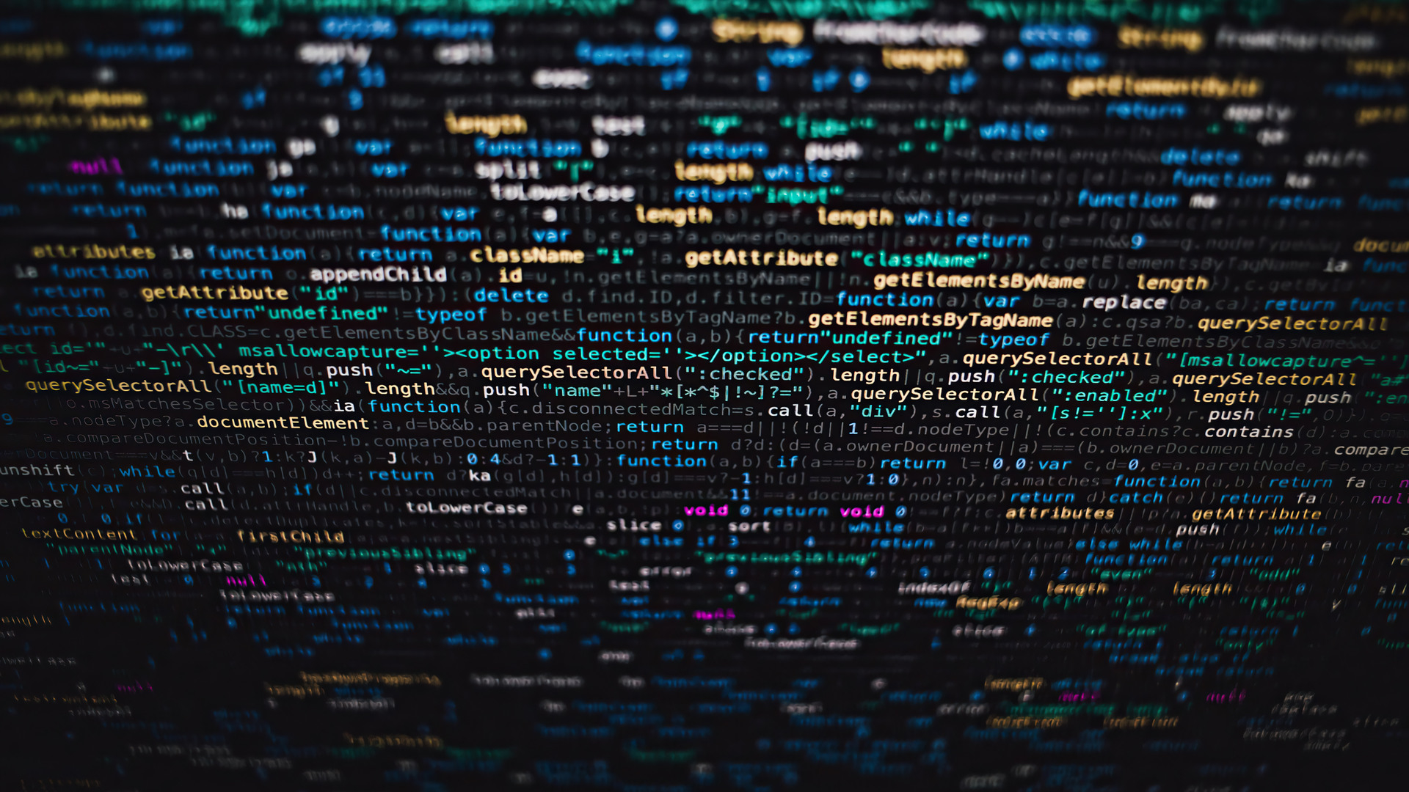
G01
Adam, Unais, Matt

Slide 2
AstroDev
AstroDev is an innovative company that has created near-instant communication between space shuttles and Earth. Utilising a network of multiple ground stations to allow spacecraft to not only send research data to earth, but also navigate to different locations in space.
For the AstroDev case study, we have used a range of technologies, including cloud storage, a private network, a dedicated data storage layer, a business logic layer, IoT integrations, and an internal API. The data we have stored in our datasets include navigation data, raw telemetry data, research data, spacecraft analytics, staff information, and system logs.
AstroDev was chosen for this case study due to its high risk appetite, which contrasts DefenseVenture which follows a medium-risk approach. This difference seemed to provide more of a challenge as there would be more to do. Additionally, space exploration is an intriguing topic which was another reason for our selection of AstroDev.
However, several ambiguities were identified in the AstroDev documentation. The system architecture and stakeholders were inconsistent throughout the document. To address this issue, we made the following assumptions:
AstroDev operates as a space agency rather than as a provider of network services to other space agencies. This is due to AstroDev using ground stations for data verification and researcher access through cloud servers.
AstroDev only had a decentralised network for security as there were no other mentions of security throughout the documentation.

Slide 3
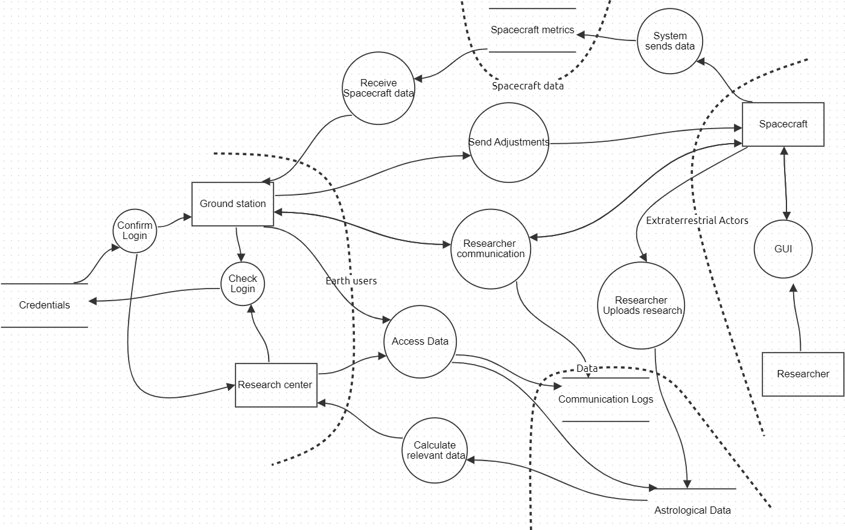
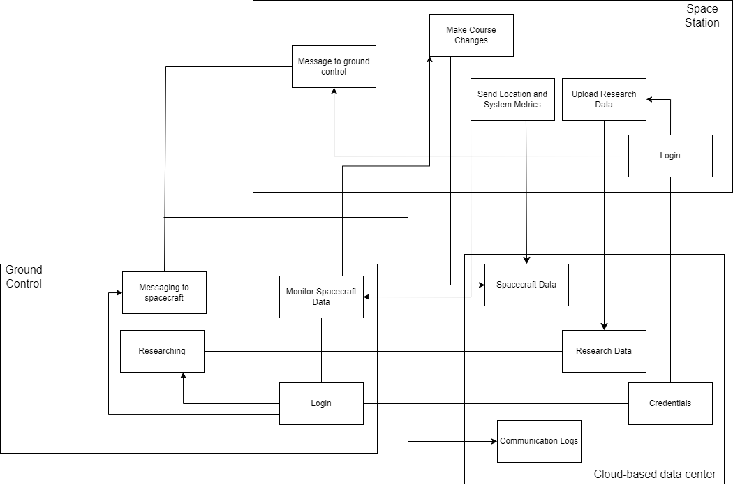
AstroDev Threat Model and Architecture
What are we working on?
We are working on AstroDevs security. This company works on transmission of data from extraterrestrial sources as well as researching the data that is sent from their space shuttles. As a company with a high risk appetite, they are prone to many attacks from external entities.
What can go wrong?
In the attempt to mitigate the security flaws, more security flaws could develop. Security flaws that are already present in the software could also lead to the risk of loss of human life on-board the space shuttles. Employee data could also be leaked if the correct security measures aren’t implemented during and after development.
What are we going to do about it?
We are going to improve the security of AstroDev by implementing different methods following the STRIDE model, as well as working with the CIA model too.
Did we do a good enough job?
Yes, after lots of consideration and identification through threat models and architecture, we believe we did a good enough job.

Slide 4
Threat ID | Threat | Threat Type | Impact | Likelihood | Risk Treatment Strategy | Action Plan | Owner | Deadline
T07 | Spoofed login pages | Spoofing | 3 | 2 | Mitigation /training | Only approved sites will be accepted and IPs will be tracked. The network will also remain closed. MFA is required for system use. | Security Engineer/ Development team | On-going
T02 | Database manipulation | Tampering | 4 | 2 | Mitigation | Database should not be accessible by anyone other than admins. Logs will also be kept. | Development team/ IT team | Sprint 1
T06 | Malicious User Gaining Access | Repudiation | 4 | 2 | Mitigation | Logs of all user activity will be kept | Security Engineer | Sprint 3
T08 | Data leak | Information disclosure | 3 | 2 | Mitigation | Minimum access privilege should be applied to reduce damage. | IT team | On-going
T03 | Denial of service | Denial of service | 5 | 2 | Mitigation | Implementation of a Web Application Firewall and only approved of data from approves IPs | DevOps | Sprint 2
T09 | Wrong permissions | Elevation of privilege | 5 | 1 | Mitigation | Minimum access privilege should be applied. | Security engineer | On-going

Slide 5
AstroDev Software Development Plan
How will you secure your development environment?
The development environment will be secured by working in a closed network away from external access. Only authorised software developers will be allowed into the development area.
List of tools for securing software development
OWASP Zap and Nmap will be used to check for any security flaws in the code. We will also use Threat Dragon to map any additional issues that may have been created in development. And we will also be using Snyk to discover any vulnerabilities built directly in the code.
Development Practises That Ensure The System Is Secure By Design And Secure By Default
To ensure that the system is secure by design, the developers will follow the architecture provided in the threat model. This will allow the development team to develop secure software.
The software will be secure by default through rigorous testing with multiple security testing tools. The software team will follow CISA to make sure that the software is secure for launch.
Security management: access to controls and secrets
Users will follow minimum access privilege to prevent data from being leaked. Minimum access will prevent staff who don’t require access to certain data from accessing the data. This will ensure that the data is secure including from the software developers. Only those who have high enough access will be able to work on certain parts of the system like the database.
Security management: Preventing Vulnerabilities
During software testing, many teams will work on finding vulnerabilities. This will all be overseen by the security engineer. Different teams will do different types of testing. Testing will follow both manual and automated testing to thoroughly look for flaws in the software.
Security management: Responding to Vulnerabilities
In the event a vulnerability is detected post-launch, the security engineer will be immediately alerted. The software will be prioritised for a patch, and depending on the severity of the issue, different teams may be assigned to assist with the handling of this issue.
Should a vulnerability be detected pre-launch the software with the vulnerability won’t be pushed until the issue is solved.

Slide 6
AstroDev SAMM Document
The OWASP SAMM score is 18.54/45
This is due to the high risk-appetite. Astrodev is primarily focusing on the secure development of their software with little afterthought of security where human life is not in imminent danger
We have added in changes to heighten security as the initial architecture of Astrodev had very little security other than using private networks and a decentralised database.
The new security implementations will now focus on:
Security in data transfer
Prevention of data tampering/repudiation
Training employees to spot different types of common attacks
Ensuring minimum access privilege is followed
This SAMM document is based on the system after mitigations have been implemented.

Slide 7

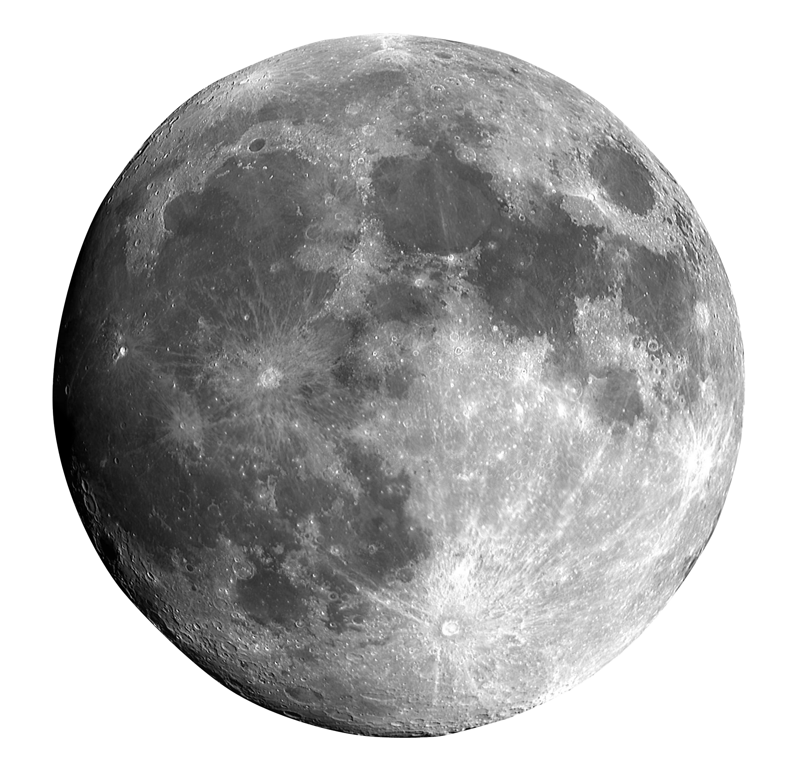
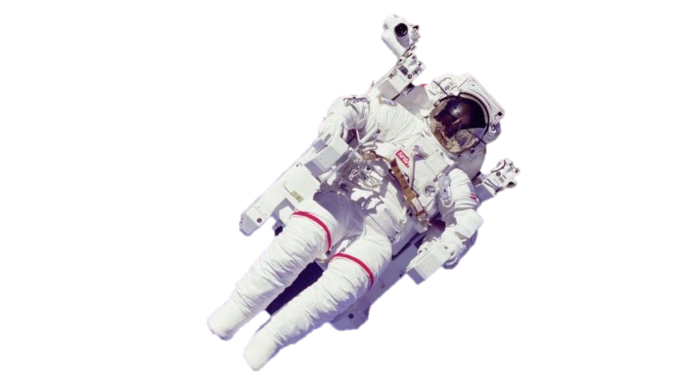
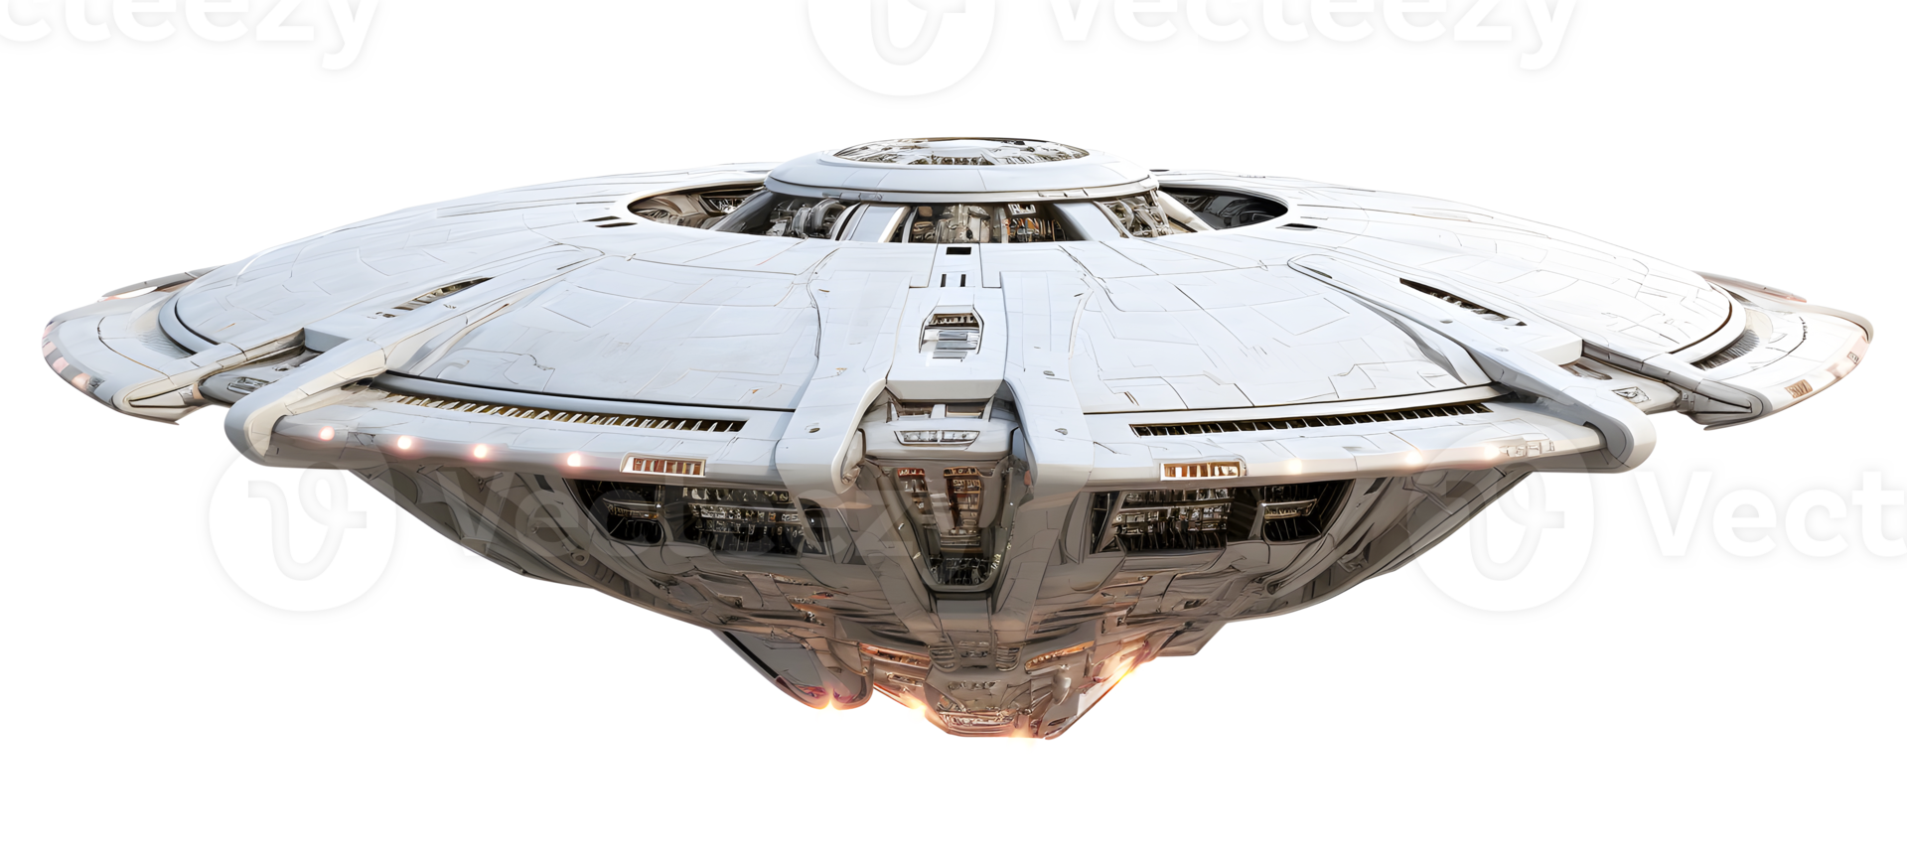
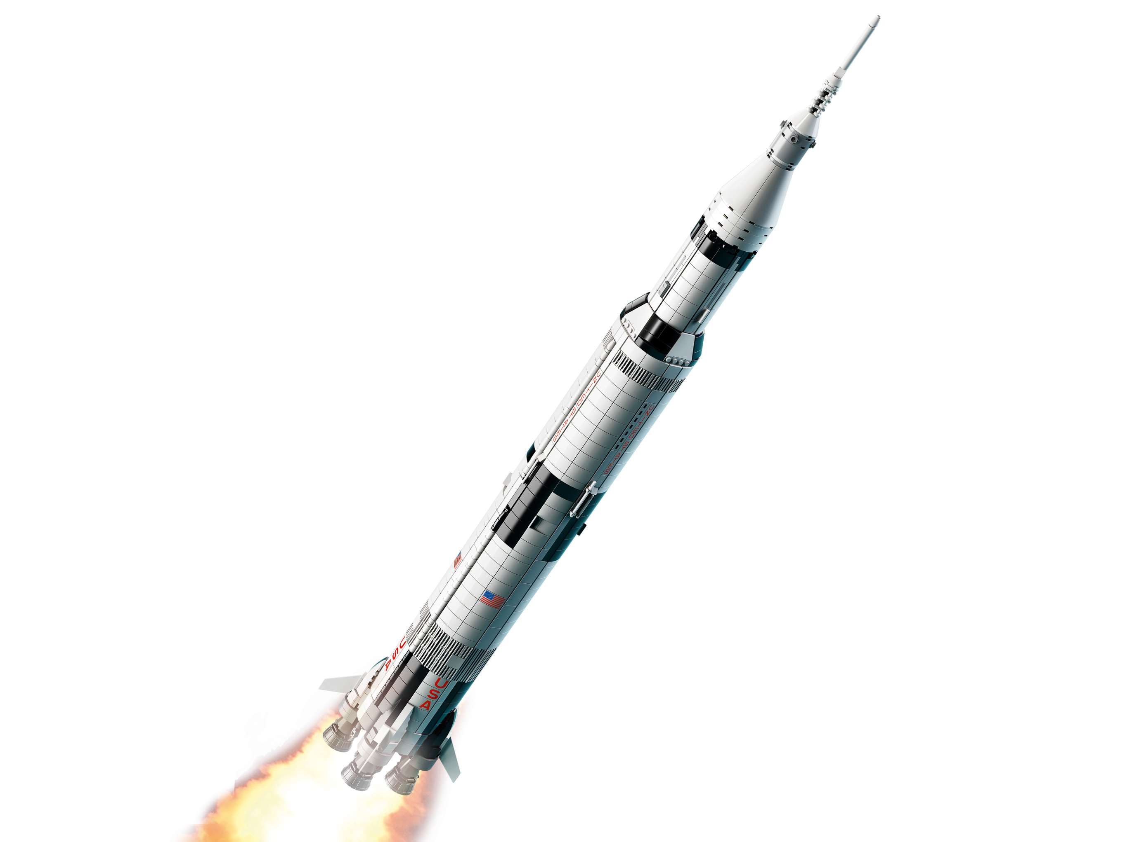
Maciej's Requirements
Title | Asset | Threat | Narrative | Work Required | Verification Criteria
(RBAC) for Mission Data | Mission data and adjustment settings | Tampering | Unauthorized access to mission data may result in detrimental modifications that impact spacecraft functionality | Use RBAC to restrict access to data according to user roles. Only designated admin roles will be able to update data | Verify logs for unwanted access attempts and confirm that only authorized roles may alter mission data
Secure Data Transmission Using TLS | Communication channels between ground control and spacecraft | Information Disclosure | Sensitive directives might be revealed via intercepted conversations, endangering mission security | Make sure that all data sent between spacecraft and ground control is encrypted using TLS | Verify that TLS is applied to all transmissions using packet inspection, and make sure that data cannot be intercepted while in transit
Regular Audit Logs for User Activity | User activity logs. | Repudiation | Malicious activity could go unnoticed without adequate recording, making it challenging to spot and track down unlawful activity | Turn on logging for all important operations, particularly those involving data access and modification | Periodically check logs to make sure all actions are correctly documented, and evaluate log access limitations to guard against manipulation

Slide 8
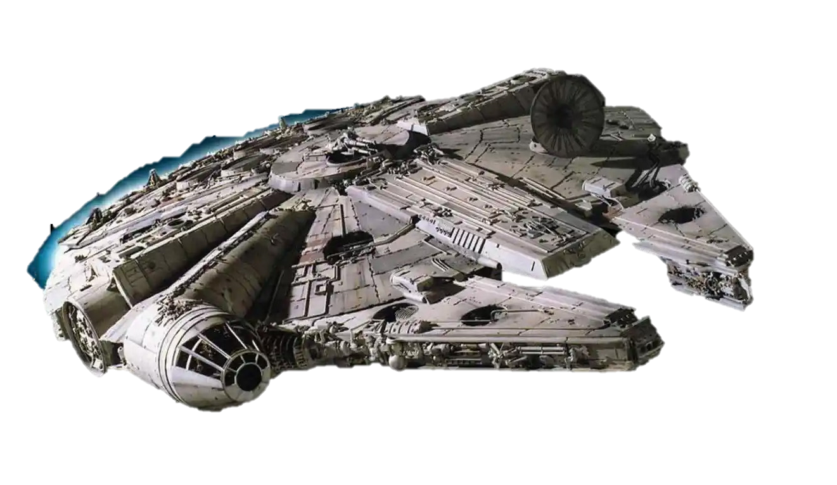
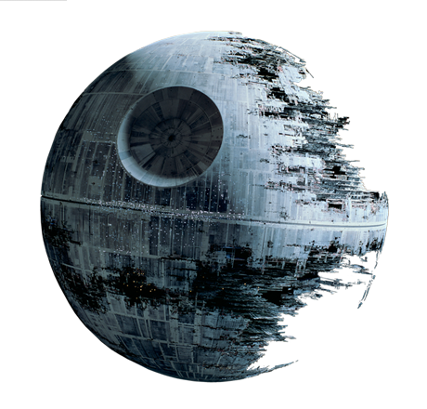
Unais's Requirements
Title | Asset | Threat | Narrative | Work Required | Verification Criteria
Preventing Denial of Services from Spaceships to Ground Control | Datasets | Denial of Service | Datasets may deny its services to the spaceship, which will prevent ground control from accessing the flight logs to then provide the next coordinates for the spaceship to fly to. | Implement appropriate authentication and authorisation methods to prevent authorised users from being locked out of access, whilst also prevent unauthorised users from access. | Test different users, from authorised to unauthorised, to investigate if the datasets deny its services appropriately.
Preventing Unauthorised Access and Updates to the User Credentials Database | User Credentials Database | Tampering and Elevation of Privilege | An unauthorised user has access to the confidential user credentials database. From there, they can modify user information and indirectly affect operations between spaceships and ground control. | Encrypt data within the database, where only authorised users can decrypt requested data. | Attempt to access data with an unauthorised user account. Rework the solution based on findings, if any at all.
Verifying User Identity to Prevent Unwanted Access to Chat Logs | Chat Data | Spoofing | Attackers may pose as authorised users to access chat logs between ground control and spaceships. | Implement Multi-Factor Authentication during account login, so that unauthorised users are locked out of confidential chat logs | Test Multi-Factor Authentication amongst different accounts.

Slide 9
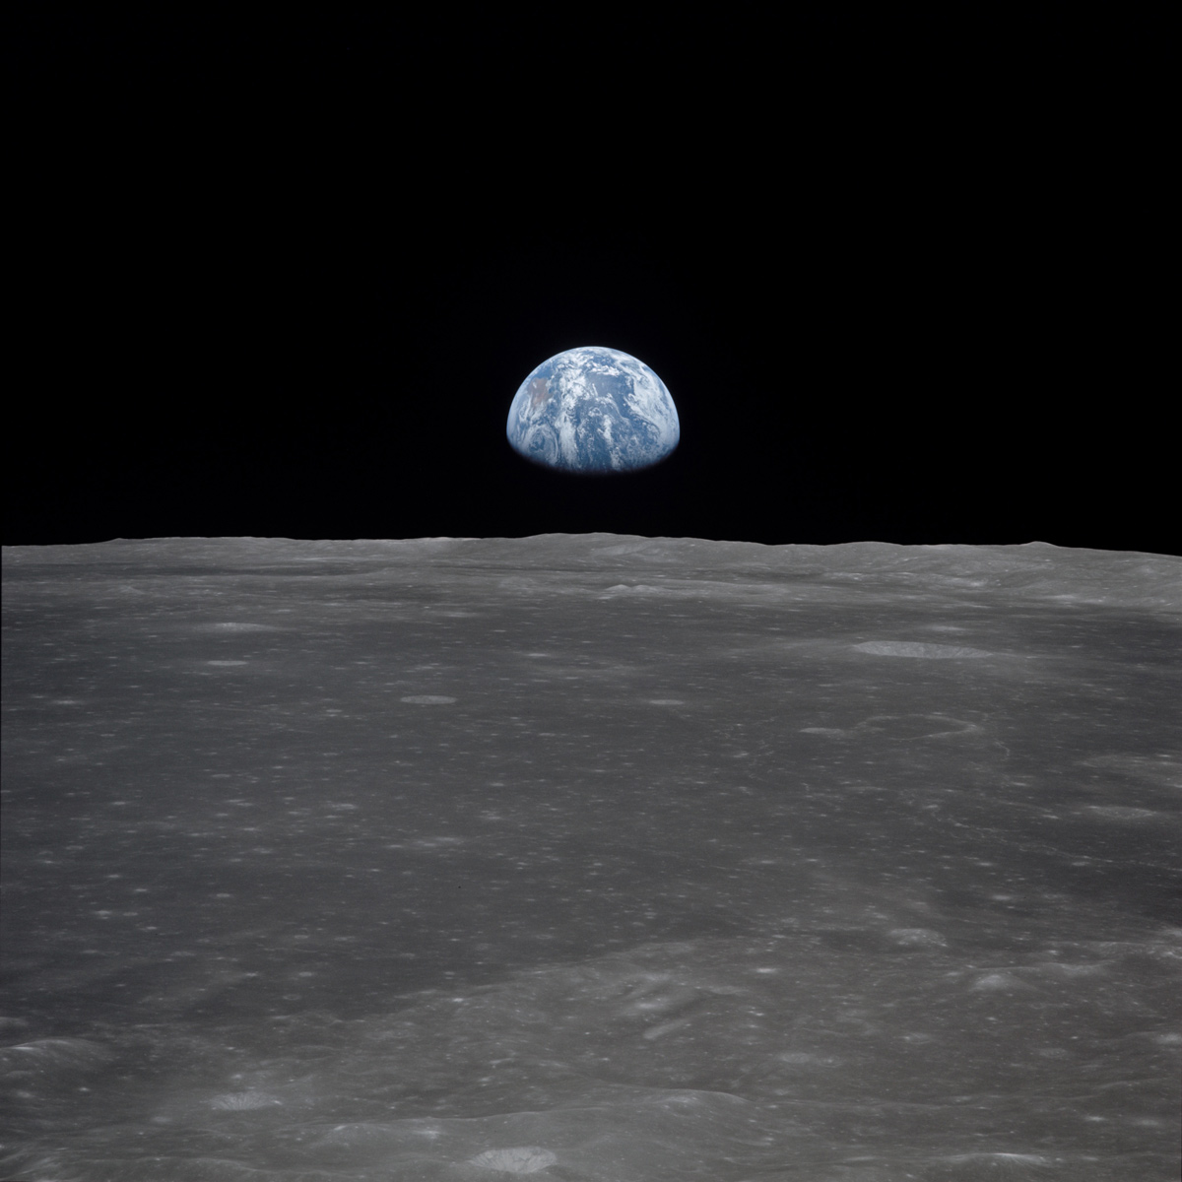
Adam Requirements
Title | Asset | Threat | Narrative | Work Required | Verification Criteria
Spoofed Pages | User accounts | Spoofing | Attacker can grab a user's details to login and gain access to the network. | Add 2FA to protect against spoofing attacks. Also ensuring that data is on a closed network | Ensure that the 2FA is working properly though login attempts ensuring that the generated password works rather than a random string of numbers, the password is generated securely, and that the computers on the closed network cannot access the live web.
Data leak from the database | User data, Sensitive data, Research Data | Disclosure of information | Staff or an attacker can gain access to sensitive data and leak it putting the company and individuals at risk | Implementation of minimum access privilege and logs to be filled out whenever data is accessed out of scope. | Test accounts at each level will attempt to access data that is outside of their scope. They will then request access to the data to a test admin account to verify whether a log has been filled before the data can be released.
Ship Logs Being tampered with | Astro data, spacecraft | Tampering, repudiation | Tampering with data can hinder with data provided by the spacecraft including important metrics | Data cannot be modified in this dataset unless by the top administrators with logs taken. | A test dataset that simulates the actual dataset, using an admin account to test the correct privileges and whether the logging system works correctly based on the requirements of the system.

